Slide 1

Hackathon 2023
Cade Wrinkle
Josh Quaintance
Nathan Roberts
OWEN KEM
(Team 12)

Slide 2
Project Challenge
Challenge 4
Real Rx Distributors, Inc is a pharmaceutical distributor in Kalamazoo, MI. They are filling a purchase order PO 8451 from Stay Well Hospital. Real Rx Distributors adheres to the Drug Supply Chain Security Act (DSCSA) and will pack the cases with the lot code, expr date and serial number. The PO has 2 line items– 10 cases of Example Drug and 10 cases of Miracle Drug.
The distributor is at 740 Forest St, Kalamazoo, MI. They are a member of GS1 US and use their company prefix to assign globally unique numbers to their business locations, they inventory the products they distribute under the manufacturer GTIN.

Slide 3
THE Problem
Too many players, not enough coordination
A lack of effective planning and risk mitigation
Difficulty addressing supply chain breakdowns

Slide 4
OUR SOLUTION
One webapp, linked to one database
Flexible integration with preexisting infrastructure
Inbuilt traceability

Slide 5
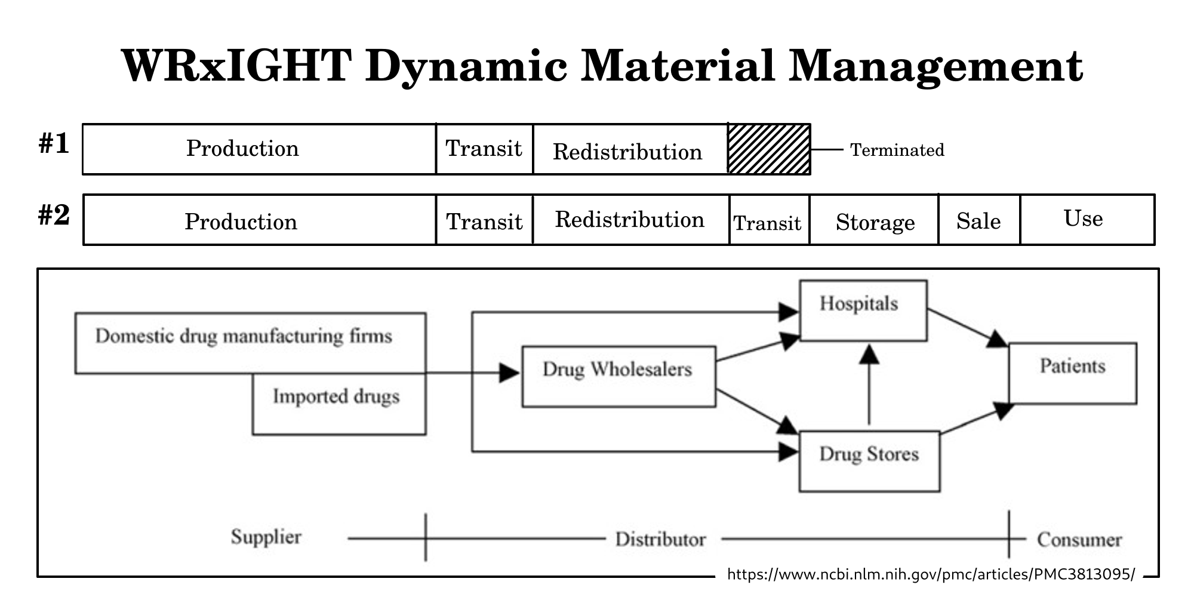
HOW IT WORKS

Slide 6
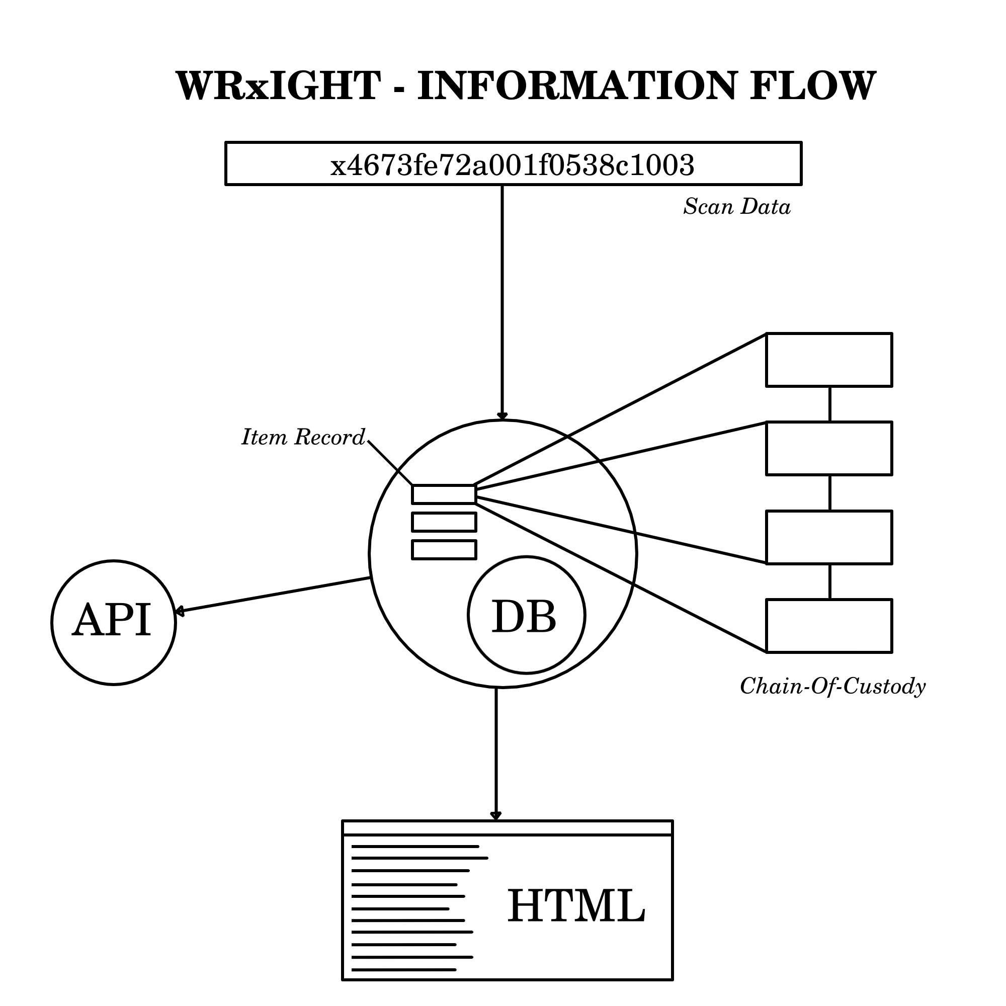
How it (really) works

Slide 7
Standards / Technology
GS1 Digital Link Toolkit
GSCC
Strapi
SvelteKit

Slide 8
WORKS CITED
McGrail, Samantha. “Fundamentals of the Pharmaceutical Supply Chain.” pharmanewsintel.com
https://pharmanewsintel.com/news/fundamentals-of-the-pharmaceutical-supply-chain
Mehralian, Gholamhossein et al. “Developing a suitable model for supplier selection based on supply chain risks: an empirical study from Iranian pharmaceutical companies.” Iranian journal of pharmaceutical research : IJPR vol. 11,1 (2012): 209-19.

Slide 9
Thank YOU!
Questions?

